Slide 1
Module 8: Using Media
SER 423

Slide 2
What do we mean by media?
In this context, media means images, audio, or videos
Some of the recipes from the book that we’ve looked at have used small images as icons from an assets folder within the project folder
We are talking about bigger images here, possibly on the file system from other apps
  Like the camera
Obviously, not all apps need sound, large images, or videos
But many bigger apps do have these in them
Here we are going to look at how both Android and iOS handle media loading and playing
Next time we will look at the code for how to make it happen in react

Slide 3
Media on Android

Slide 4
API and Permissions
Android provides two basic classes for playing media
AudioAttributes- This manages audio sources and audio output only
MediaManager - This class provides the primary API for playing sounds or video
Basically, use AudioAttributes to set up your sound settings and MediaManager for actually playing the media
You will also probably want two permissions in the manifest file
Internet Permission - If you are loading or streaming your media from the internet, you need to request network access
Wake Lock Permission - This will allow you to prevent the screen from locking or dimming while the media is playing
  The User may well not interact with their phone much while the media is playing

Slide 5
Asynchronous Playing
You will pretty much always want to use an asynchronous process to load a media file
  As you’ll see next time, the react component requires asynchronous use
Like many things with asynchronous processes, we do this because we cannot be sure how long it will take to load the media
This is particularly important when streaming data from the web, but still applies when loading media from the local system
MediaManager has a prepare method you can call to start buffering
You then call start to actually start playing the media when it is loaded
You should kick off prepare as soon as possible and put start behind a flag that is set by a callback when the async process completes

Slide 6
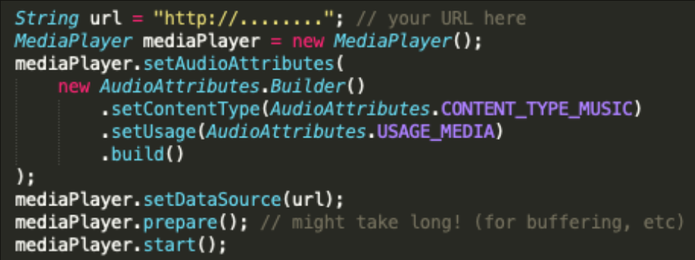
Android Example

Slide 7
Android Local Example

Slide 8
Media on iOS

Slide 9
The iOS API
iOS has a single class for managing media called AVFoundation
This does a lot
  Import/Export of Assets, Playback, Capture, Editing, and even Speech Synthesis
We’re mostly concerned with how it handles media playback
In order to setup the audio session you need to start with the didFinishLaunchingWithOptions app lifecycle method
From here you can retrieve the shared instance of the audio session
With this session you can set the session category to to playback and the mode to moviePlayback
You then just need to implement the playback behavior yourself

Slide 10
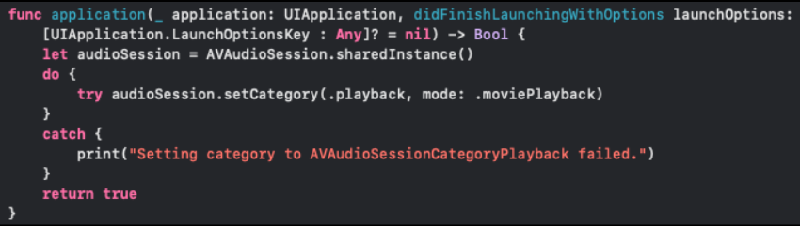
Configuring the Audio Session

Slide 11
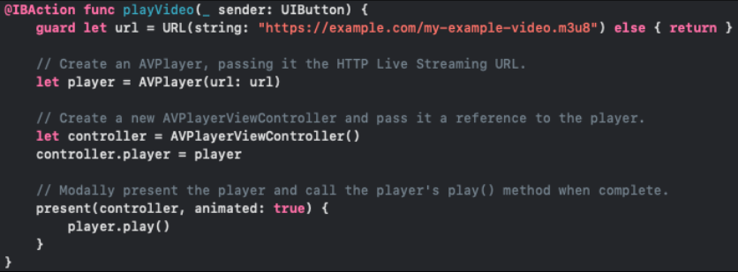
Implementing the Playback

Slide 12
Final Thoughts

Slide 13
Wrapping Up
Fortunately, react provides us a way to do media on both platforms
  We will have to supply a few platform specific flags
Both platforms have interrupt options to prevent apps fighting over audio
Options include:
  DoNotMix
  DuckOthers
  MixWithOthers
    iOS only
Again, design your apps to load media asynchronously

Slide 14
End of Using Media
Next time - Building a Media Player

